Slide 1
CSE 486/586 Distributed Systems Google Chubby Lock Service
Steve Ko
Computer Sciences and Engineering
University at Buffalo

Slide 2
Recap
Paxos is a consensus algorithm.
Proposers?
Acceptors?
Learners?
A proposer always makes sure that,
If a value has been chosen, it always proposes the same value.
Three phases
Prepare: “What’s the last proposed value?”
Accept: “Accept my proposal.”
Learn: “Let’s tell other guys about the consensus.”

Slide 3
Google Chubby
A lock service
Enables multiple clients to share a lock and coordinate
A coarse-grained lock service
Locks are supposed to be held for hours and days, not seconds.
In addition, it can store small files.
Design target
Low-rate locking/unlocking
Low-volume information storage
Why would you need something like this?

Slide 4
Google Infrastructure Overview
Google File System (GFS)
Distributed file system
Bigtable
Table-based storage
MapReduce
Programming paradigm & its execution framework
These rely on Chubby.
Warning: the next few slides are intentionally shallow.
The only purpose is to give some overview.

Slide 5
CSE 486/586 Administrivia
No class next Friday
Please go to the grad conference instead!
Keynote Speaker: Emin Gun Sirer from Cornell (will talk about his new distributed storage called HyperDex---very relevant to the topics of this class!)
Project 2
Deadline: 4/13 (Friday) @ 2:59PM
Project 3 will be released on Friday.
Final
5/7 (Monday), 3:30PM - 6:30PM
Norton 112

Slide 6
Google File System
A cluster file system
Lots of storage (~12 disks per machine)
Replication of files to combat failures
CPU
CPU
CPU
CPU
CPU
CPU
CPU
CPU
CPU
CPU
CPU
CPU
CPU
CPU
CPU
CPU
CPU
CPU
CPU
CPU
CPU
CPU

Slide 7
Google File System
Files are divided into chunks
64MB/chunk
Distributed & replicated over servers
Two entities
One master
Chunk servers

Slide 8
Google File System
Master maintains all file system metadata
Namespace
Access control info
Filename to chunks mappings
Current locations of chunks
Master replicates its data for fault tolerance
Master periodically communicates with all chunk servers
Via heartbeat messages
To get state and send commands
Chunk servers respond to read/write requests & master’s commands.

Slide 9
Bigtable
Table-based storage on top of GFS
Main storage for a lot of Google services
Google Analytics
Google Finance
Personalized search
Google Earth & Google Maps
Etc.
Gives a large logical table view to the clients
Logical tables are divided into tablets and distributed over the Bigtable servers.
Three entities
Client library
One master
Tablet servers

Slide 10
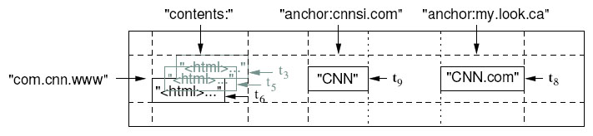
Bigtable
Table: rows & columns
(row, column, timestamp) -> cell contents
E.g., web pages and relevant info.
Rows: URLs
Columns: actual web page, (out-going) links, (incoming) links, etc.
Versioned: using timestamps

Slide 11
MapReduce
Programming paradigm
Map: (key, value) → list of (intermediate key, intermediate value)
Reduce: (intermediate key, list of intermediate values) → (output key, output value)
Programmers write Map & Reduce functions within the interface given (above).
Execution framework
Google MapReduce executes Map & Reduce functions over a cluster of servers
One master
Workers

Slide 12
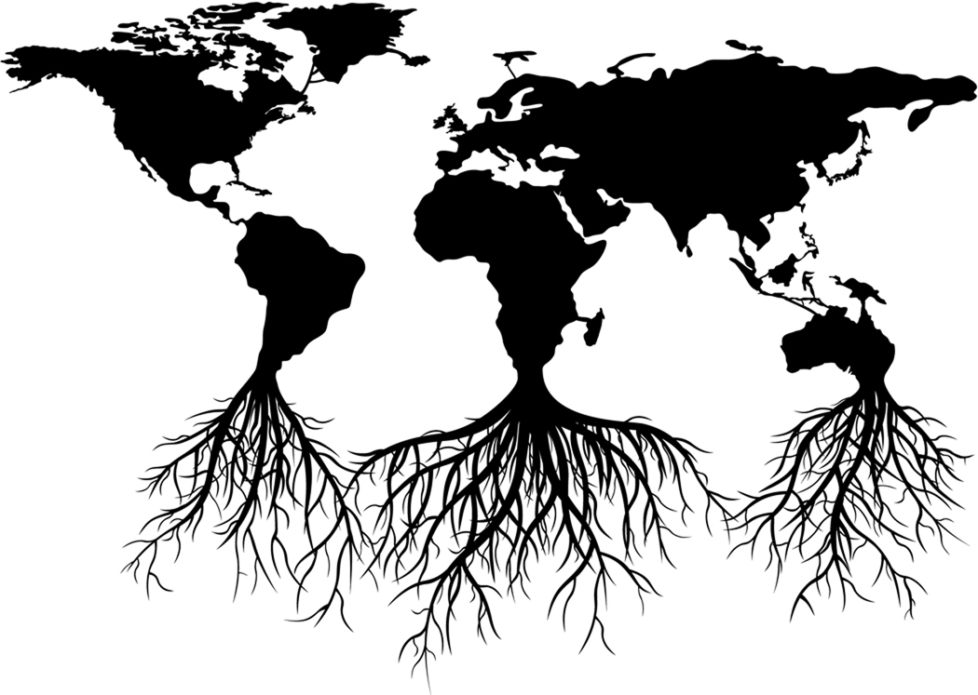
Map
Interface
Input: <in_key, in_value> pair => <url, content>
Output: list of intermediate <key, value> pairs => list of <word, url>
<every, http://url0.com>
<happy, http://url0.com>
<family, http://url0.com>
…
key = http://url0.com
value = “every happy family is alike.”
map()
<every, http://url1.com>
<unhappy, http://url1.com>
<family, http://url1.com>
…
key = http://url1.com
value = “every unhappy family is unhappy in its own way.”
Map Input: <url, content>
Map Output: list of <word, url>

Slide 13
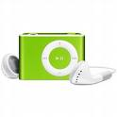
Shuffle
MapReduce system
Collects outputs from all map executions
Groups all intermediate values by the same key
<every, http://url0.com>
<happy, http://url0.com>
<family, http://url0.com>
…
every -> http://url0.com
http://url1.com
happy -> http://url0.com
<every, http://url1.com>
<unhappy, http://url1.com>
<family, http://url1.com>
…
unhappy -> http://url1.com
family -> http://url0.com
http://url1.com
Map Output: list of <word, url>
Reduce Input: <word, list of urls>

Slide 14

Reduce
Interface
Input: <out_key, list of intermediate_value>
Output: <out_key, out_value>
every -> http://url0.com
http://url1.com
<every, “http://url0.com,
http://url1.com”>
reduce()
happy -> http://url0.com
<happy,
“http://url0.com”>
unhappy -> http://url1.com
<unhappy,
“http://url1.com”>
family -> http://url0.com
http://url1.com
<family, “http://url0.com,
http://url1.com”>
Reduce Input: <word, list of urls>
Reduce Output: <word, string of urls>

Slide 15
MapReduce
Execution flow
Master
Input files sent to map tasks
Intermediate keys partitioned into reduce tasks
M
R
M
Input Files
R
Output
M
Reduce workers
Map workers

Slide 16

Common Theme
One master & multiple workers
Why one master?
This design simplifies lots of things.
Mainly used to handle meta data; it’s important to reduce the load of a single master.
No need to deal with consistency issues
Mostly fit in the memory → very fast access
Obvious problem: failure
How would you use a lock service like Chubby?

Slide 17
Chubby
A coarse-grained lock service
Locks are supposed to be held for hours and days, not seconds.
In addition, it can store small files.
Used for various purposes (e.g., the master election) for GFS, Bigtable, MapReduce
Potential masters try to create a lock on Chubby
The first one that gets the lock becomes the master
Also used for storing small configuration data and access control lists

Slide 18
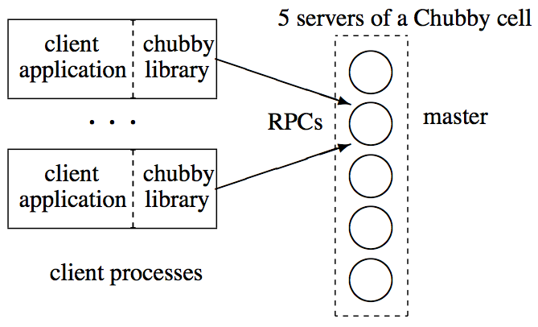
Chubby Organization
Chubby cell (an instance) has typically 5 replicas.
But each cell still serves tens of thousands of clients
Among 5 replicas, one master is elected.
Any one replica can be the master.
They decide who is the master via Paxos.
The master handles all requests.

Slide 19
Client Interface
File system interface
From a client’s point of view, it’s almost like accessing a file system.
Typical name: /ls/foo/wombat/pouch
ls (lock service) common to all Chubby names
foo is the name of the Chubby cell
/wombat/pouch interpreted within Chubby cell
Contains files and directories, called nodes
Any node can be a reader-writer lock: reader (shared) mode & writer (exclusive) mode
Files can contain a small piece of information
Just like a file system, each file is associated with some meta-data, such as access control lists.

Slide 20
Client-Chubby Interaction
Clients (library) send KeepAlive messages
Periodic handshakes
If Chubby doesn’t hear back from a client, it’s considered to be failed.
Clients can subscribed to events.
E.g., File contents modified, child node added, removed, or modified, lock become invalid, etc.
Clients cache data (file & meta data)
If the cached data becomes stale, the Chubby master invalidates it.
They Chubby master piggybacks events or cache invalidations on the KeepAlives
Ensures clients keep cache consistent

Slide 21
Client Lock Usage
Each lock has a “sequencer” that is roughly a version number.
Scenario
A process holding a lock L issues a request R
It then fails & lock gets freed.
Another process acquires L and perform some action before R arrives at Chubby.
R may be acted on without the protection of L, and potentially on inconsistent data.

Slide 22
Client API
open() & close()
GetContentsAndStat()
Reads the whole file and meta-data
SetContents()
Writes to the file
Acquire(), TryAcquire(), Release()
Acquires and releases a lock associated with the file
GetSequencer(), SetSequencer(), CheckSequencer()

Slide 23
Primary Election Example
All potential primaries open the lock file and attempt to acquire the lock.
One succeeds and becomes the primary, others become replicas.
Primary writes identity into the lock file with SetContents().
Clients and replicas read the lock file with GetContentsAndStat().
In response to a file-modification event.

Slide 24
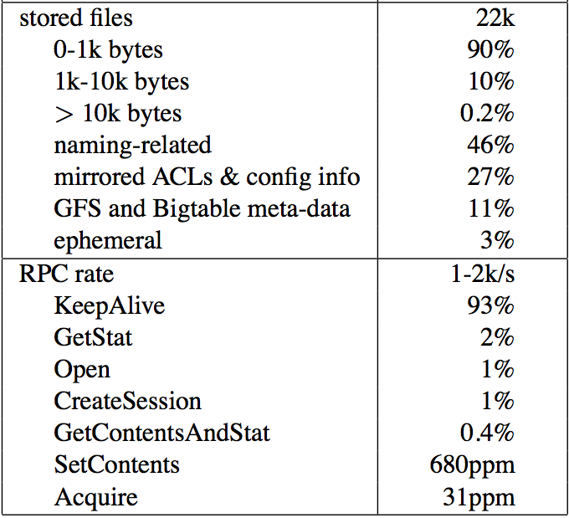
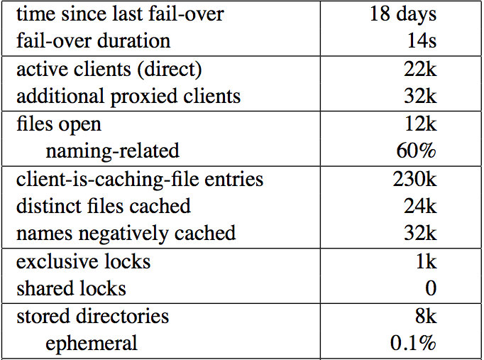
Chubby Usage
A snapshot of a Chubby cell
Few clients hold locks, and shared locks are rare.
Consistent with locking being used for primary election and partitioning data among replicas.

Slide 25
Acknowledgements
These slides contain material developed and copyrighted by Indranil Gupta (UIUC).

